Slide 1
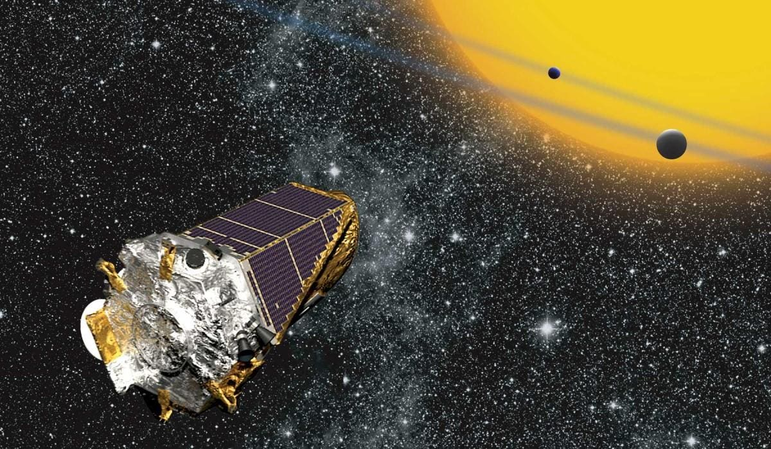
Binary Classification of Kepler Objects of Interest with Supervised Machine & Deep Learning Methods
Lelia Deville
Systems Engineering – Mechanical Concentration, PhD Student

Slide 2
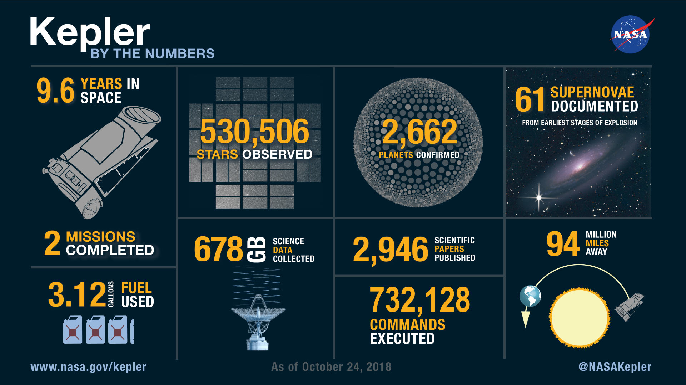
Notes:
Kepler space telescope was the first planet-hunting telescope
Uncovered the potential for the existence of billions of exoplanets
Obtained thousands of observations on Kepler Objects of Interest (KOI)

Slide 3
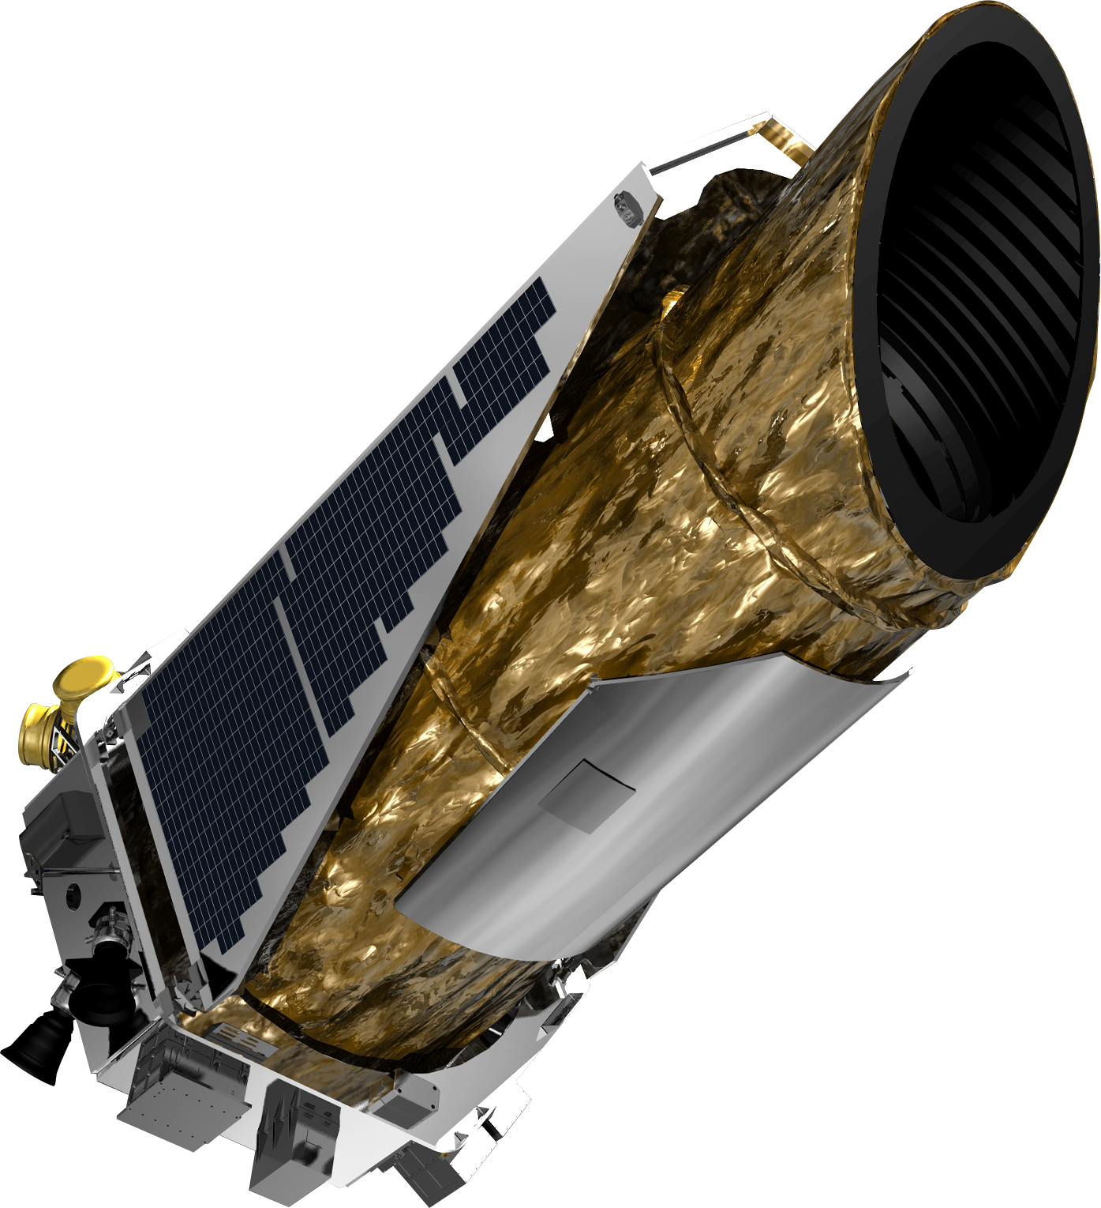
About the dataset
NASA Exoplanet archive
Specifically used KOI table – with 9564 total entries
Objects are classified as confirmed, candidate, and false positive
False positive objects remain to provide valuable info
Notes:
Exoplanet archive contains data on thousands of confirmed exoplanets and other objects of interest not just from the kepler mission but from any valid observation of a candidate exoplanet
Objects later found to not be an exoplanet remain in the data base as a ‘False Positive’ since the data can be valuable for determining if future objects are exoplanets or not
There is a table just for objects of interest found by the kepler & K2 missions – these include classes like candidate, confirmed, and false positive

Slide 4
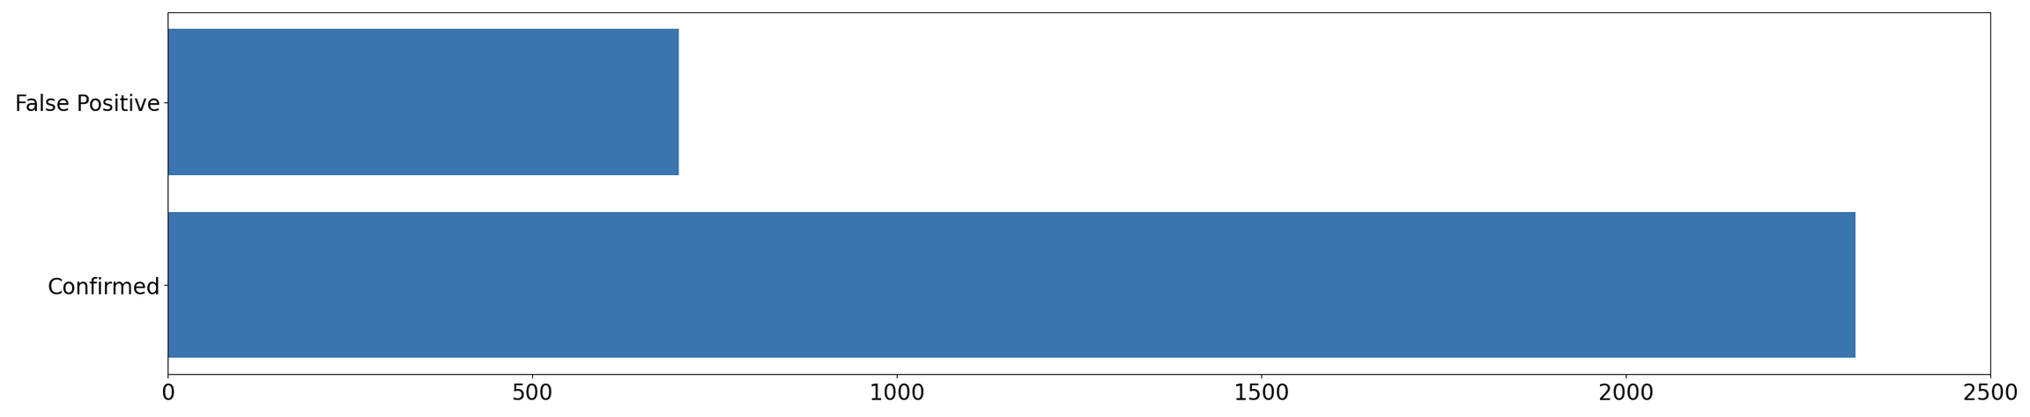
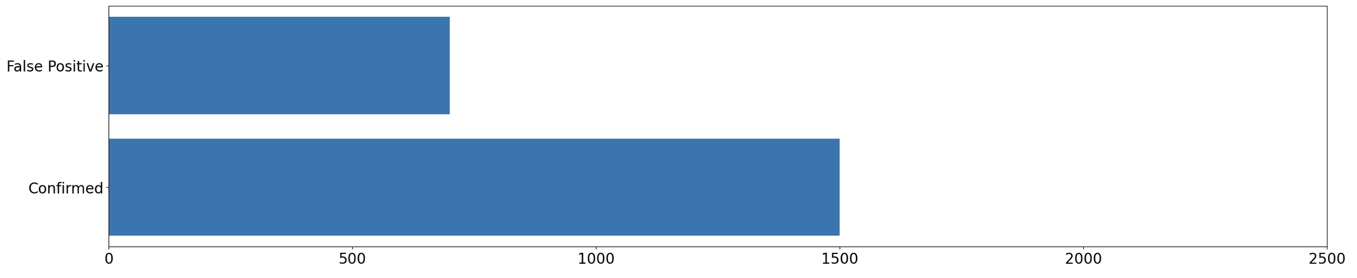
Dataset Contents
*Also contained candidates – to be addressed later
Notes:
Had to reduce the ratio because the models were extremely bias towards confirmed. Wanted to keep a higher majority so reduced 3.3:1 down to 2:1

Slide 5
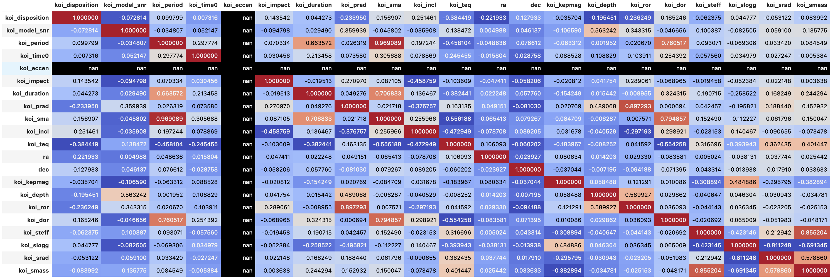
Collinearity Check
Normally we want to avoid this, but it will work out in future steps…

Slide 6
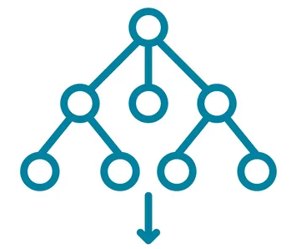
About the model
This problem requires a classification model
Data comes with the labels (confirmed, false positive etc.) so this is called supervised learning
Many options (some were tested – SVC, MLPClassifier), but Random Forest chosen
Machine Learning
Two datasets tested:
Planetary + Stellar Data
Planetary Data

Slide 7
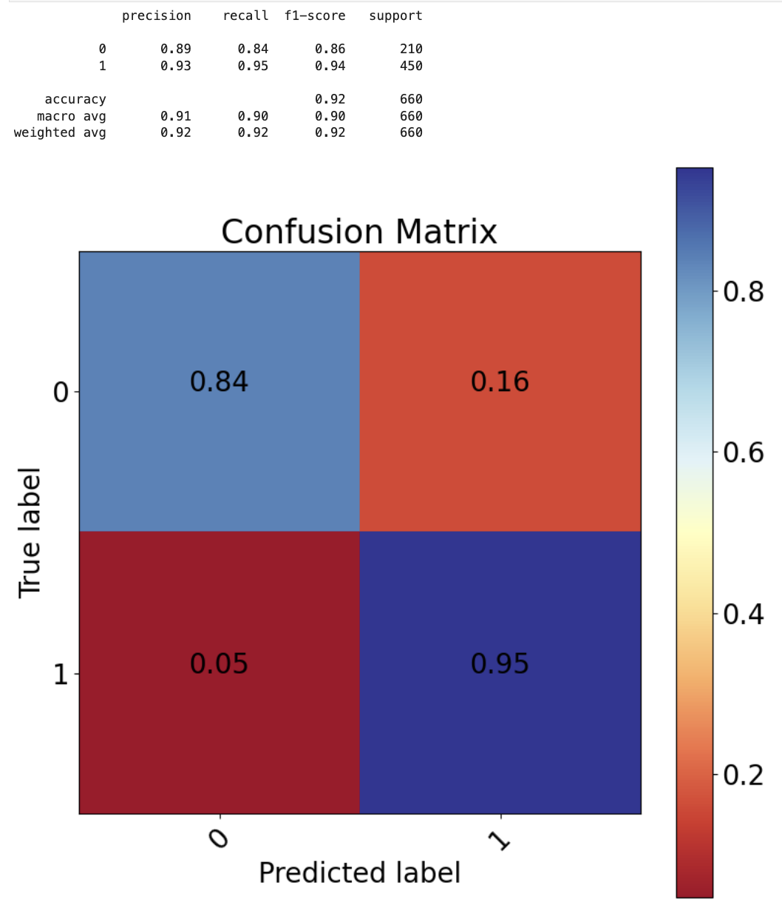
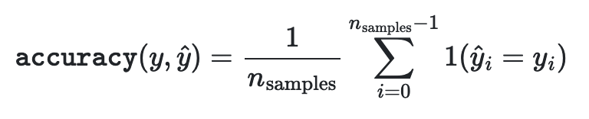
Planetary + Stellar
Overall Accuracy score of 92%
There were 2x as many 1 (Confirmed), so it makes sense the model is better at classifying these

Slide 8
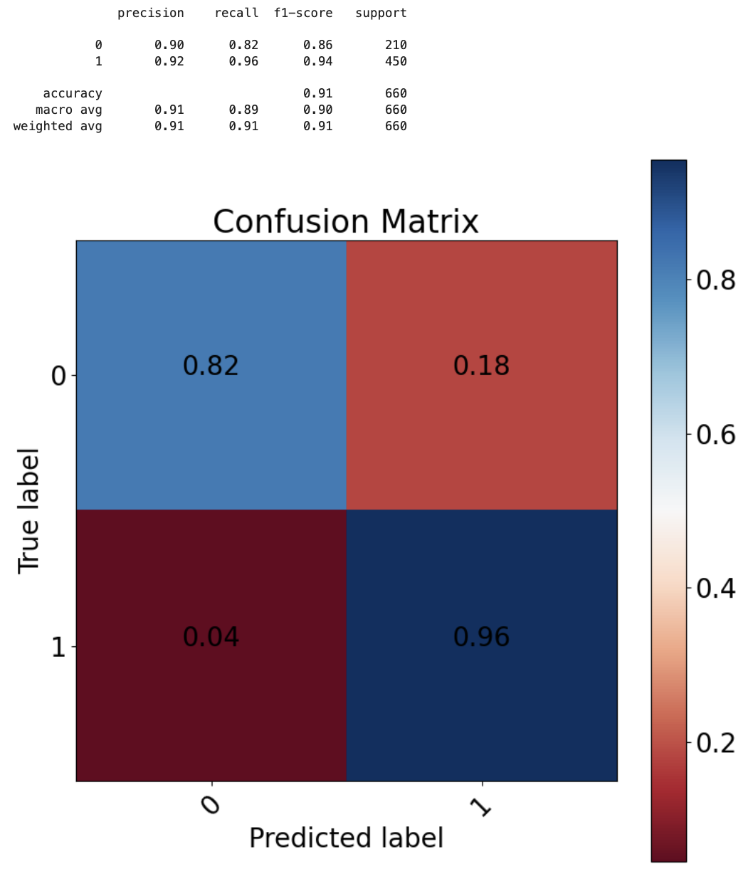
Planetary
Overall Accuracy score of 91%
Still slightly imbalanced, but not much different
Removed all stellar parameters (mass, radius, etc.) but saw no major change in model performance

Slide 9
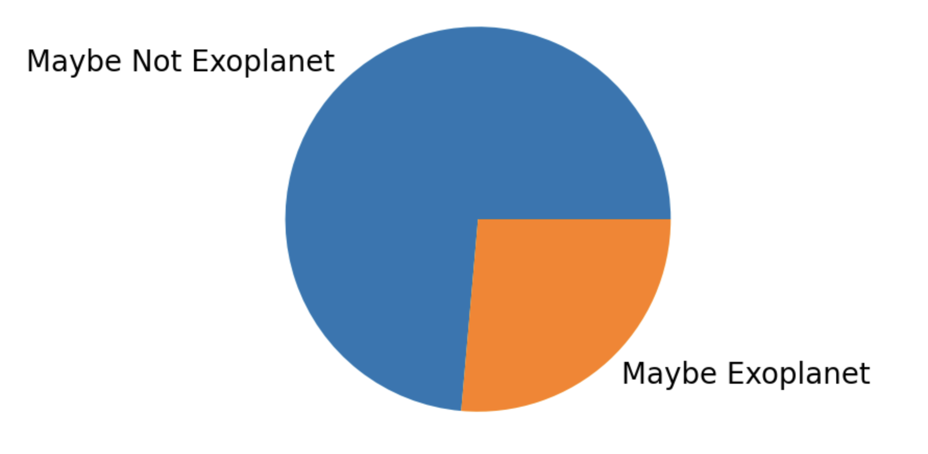
Candidate Dataset
Recall the portion of planets classified as candidate
Based on initial proportion (3.3:1 confirmed/false positive), this seems unlikely? Unless?
The model was up to 96% accurate in classifying the confirmed objects - & 85% in classifying the false positives, so this could be plausible
Maybe conservative labeling is better?

Slide 10
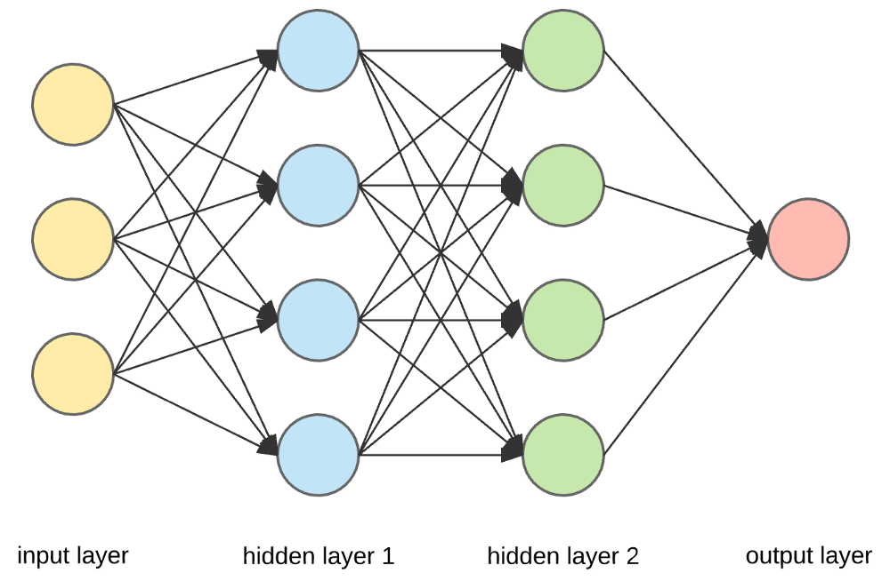
Deep learning: About the model
Wanted to try a simple Deep Learning Model
Machine Learning vs Deep Learning
Neural Network with only 2 hidden layers
‘Black Box’ Model

Slide 11

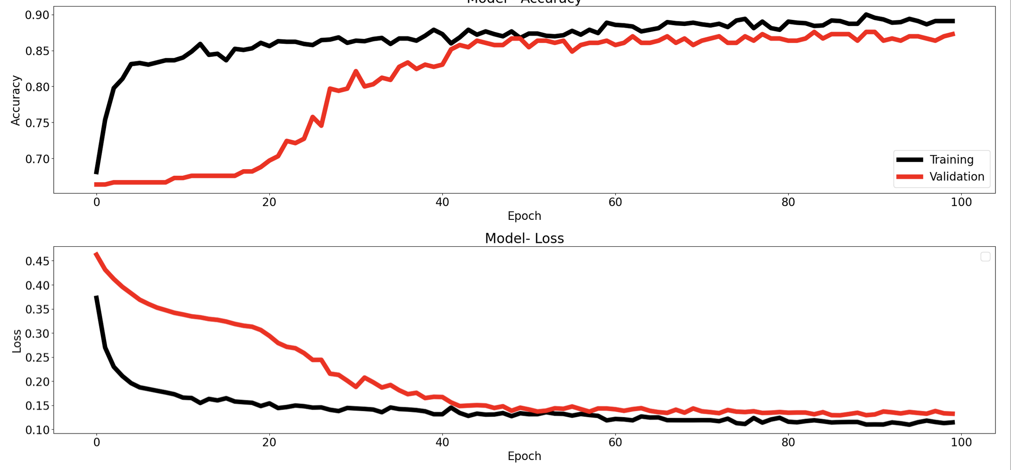

Slide 12
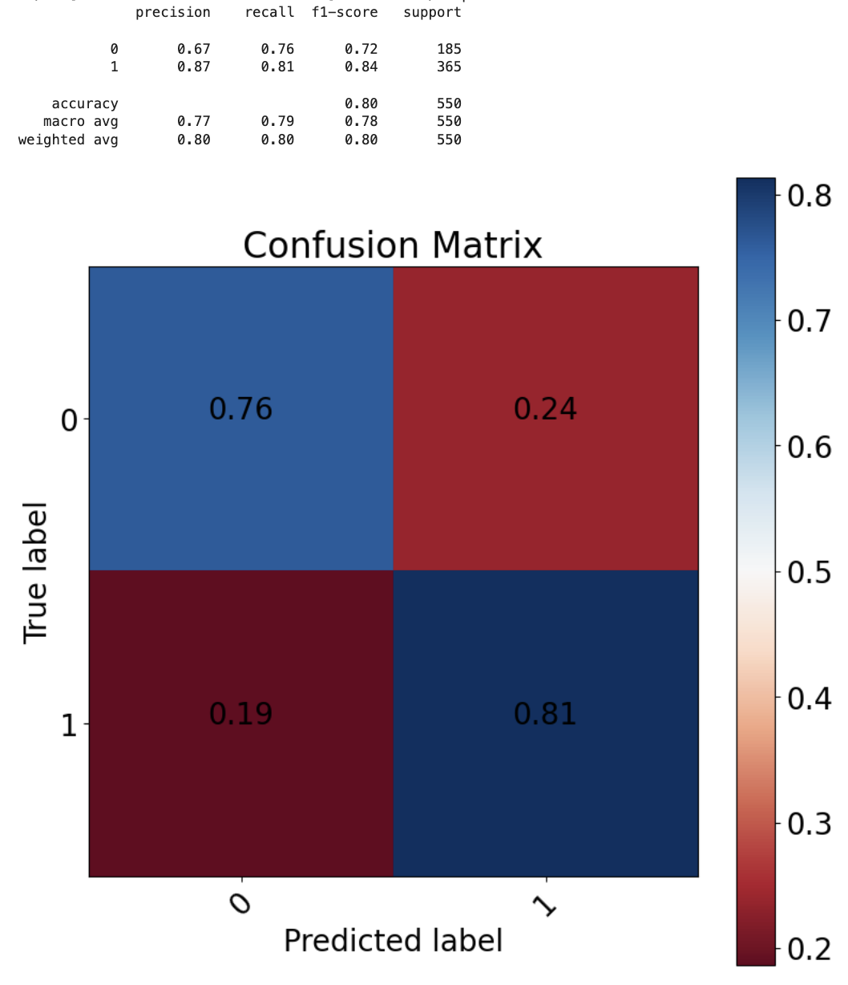
NN - Planetary
Overall Accuracy score of 80%
Not that great (comparatively)
Models require layers with density, normalization, and more
To train they require optimizers, loss functions, etc
Likely some user error causing subpar performance

Slide 13
Summary
Classification of objects of interest using different size datasets & models
Simple Machine Learning models were good on the fly – deep learning likely will outperform if used correctly
Future work could include one-class classification, including analysis of probabilities to determine which objects are worth pursuing first

Slide 14
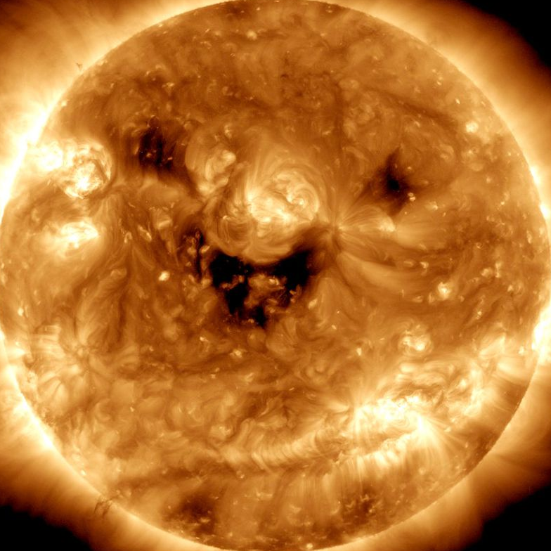
Thank You!
Questions?

